Slide 1


Supervised By
TA/ Nesma
DR/ GHADA TOLAN
EGY.Stock
Sherif Yasser
20200764
Basmala Zakaria
20210598
Mohanad Arafa
20200563
Mohamed Ahmed
20200423
Nada Mamdouh
20200593
Graduation Project
Academic Year 2023-2024
Final Presentation

Slide 2





Project team members
Sherif Yasser
Mohanad Arafa
Nada Mamdouh
Mohamed Ahmed
Basmalla Zakaria

Slide 3

INTRODUCTION

Slide 4

INTRODUCTION
The Impact of technology on making life rapid.
The fear of Time-consuming and Complexity in Stocks Market.
Making it easy and simple for user to keep tracking Stocks.
Maintaining the all essential Analysis for Investors.

Slide 5

OBJECTIVES
Providing a good and useful Analysis.
Making a Reliable Model that can Predict the Stock Price.
Evaluating the model and getting the Optimal accuracy score.
Alert the user before significant Increasing or Decreasing in the Price

Slide 6

PROJECT
STEPS

Slide 7


PROJECT STEPS
Data Analysis
Data Collection
Data collection is a critical step in creating an accurate machine learning model. We gathered historical stock market data for Egyptian companies from Investing.com, including prices and volumes. The companies included are:
ABUK (Abu Qir Fertilizers)
MFPC (Misr Fertilizers Production Co)
EGAL (Egypt Aluminum)
AXPH (Alexandria Pharmaceuticals)
ESRS (Ezz Steel)

Slide 8
PROJECT STEPS
Data Analysis
Data Preprocessing
Data preprocessing is essential for developing efficient machine learning models. Key techniques used in financial risk assessment include:
Data Cleaning
Imputing Missing Values: Ensuring the model can use all available data by filling in missing values using the forward fill method.
Handling Outliers: Outliers, which deviate significantly from the rest of the data, are carefully managed due to the sensitivity of stock market data.

Slide 9
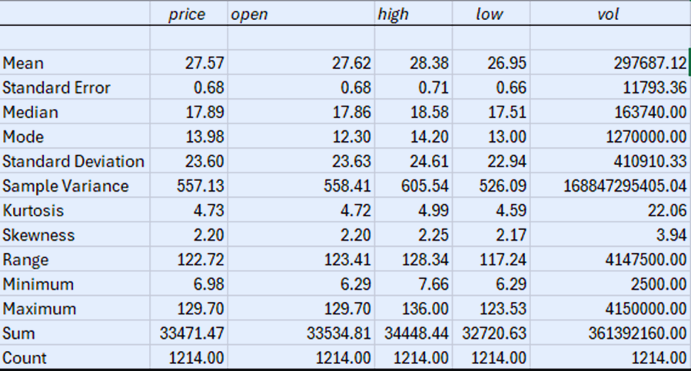
PROJECT STEPS
Data Analysis
Exploratory data analysis (EDA):
Exploratory data analysis (EDA) is an important step as it allows us to gain insight into the data that allows us to understand our data and can be used to make predictions.
For example, we made a summary statistic for the EGAL company
FIGURE DESCRIPTIVE STATISTIC FOR THE EGAL COMPANY

Slide 10

PROJECT STEPS
Data Analysis
Data Visualization
Data visualization helps display data in meaningful ways, making it easier to study and analyze. It supports better decision-making by allowing for value comparisons. Key visualization s in our project include:

Slide 11
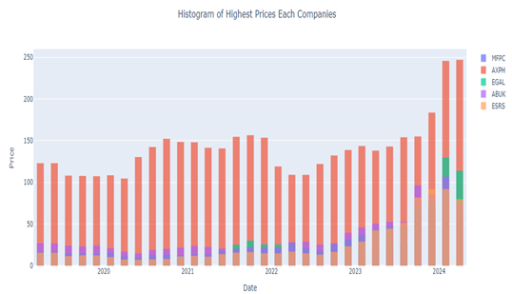
PROJECT STEPS
Data Analysis
Histogram of Highest Prices: This histogram visualizes the highest prices of the companies over the past 5 years. It shows that AXPH (Alexandria Pharmaceuticals) has the highest prices, while ESRS (Ezz Steel) has the lowest.
Figure The highest prices at the companies

Slide 12
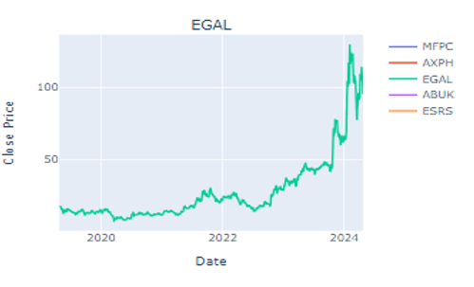
PROJECT STEPS
Data Analysis
And this is a line chart for each company to see in details how the prices change over the years, here we can see that AXPH with the highest prices have a significant changes over the years, from 2020 to 2022 the price start to increase but after this period we can see that the prices dropped down again and then it has the highest prices by the year 2024.
Figure 5 Closing Prices at each company

Slide 13
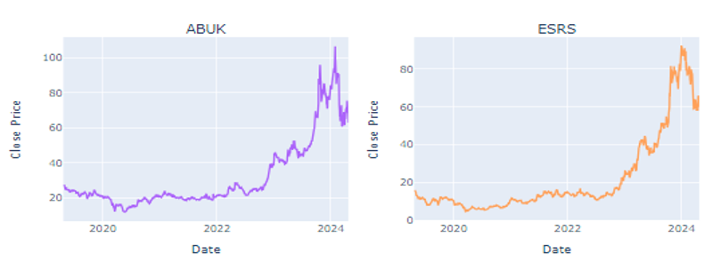
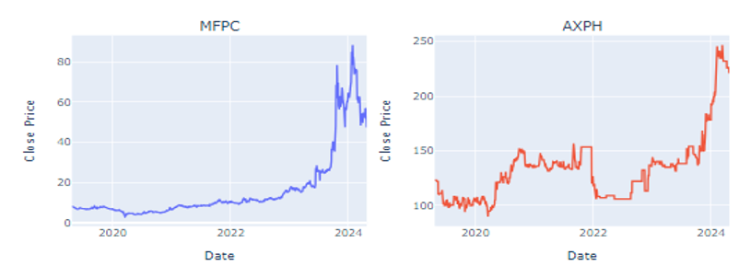
PROJECT STEPS
Data Analysis
Figure Closing Prices at each company

Slide 14
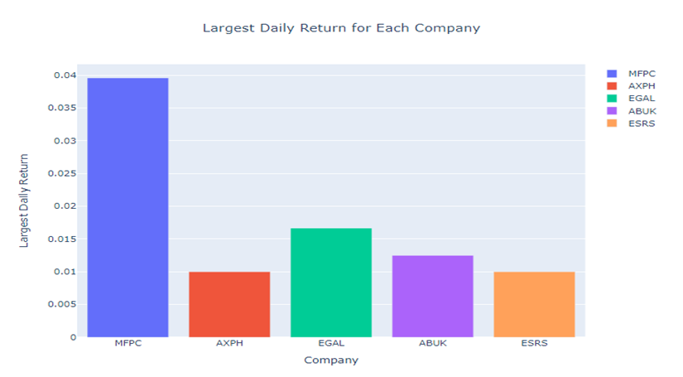
PROJECT STEPS
Data Analysis
A histogram to see the maximum daily return for each company and we see that MFPC has the highest, ESRS and AXPH equally have the lowest:
FIGURE LARGEST DAILY RETURN FOR EACH COMPANY

Slide 15
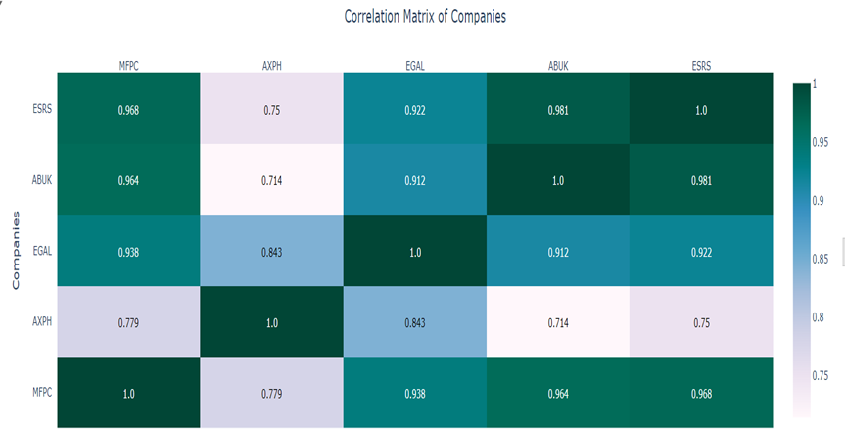
PROJECT STEPS
Data Analysis
Then Calculate the correlation matrix to determine the relationship between the stock prices of different companies to know how the stock prices of various companies move in relation to each other.
FIGURE CORRELATION MATRIX OF COMPANIES

Slide 16
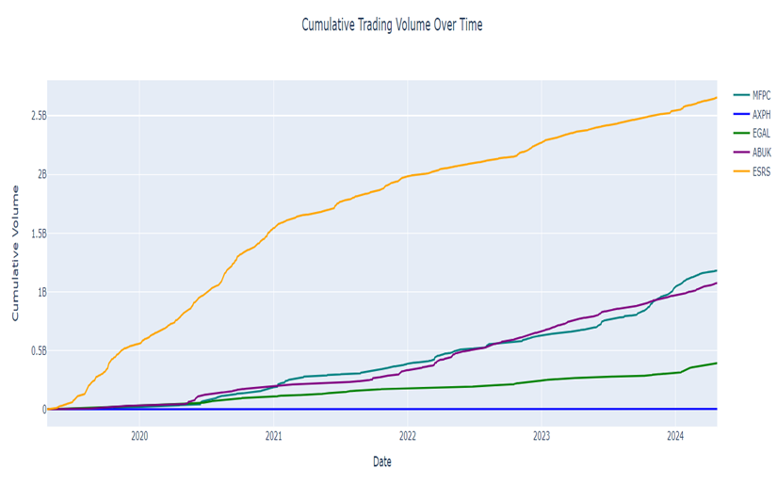
PROJECT STEPS
Data Analysis
To analyze the trading volume trends of different companies over time by calculating and visualizing their cumulative trading volumes.
FIGURE CUMULATIVE TRADING VOLUME OVER TIME

Slide 17
PROJECT STEPS
Data Analysis
Then to choose the most appropriate company to build our model and train the data, we need to calculate the expected risk and return for each company and start to compare:
Risk: It calculates the standard deviation (std) of daily returns for each company, representing the volatility or risk.
Expected Return: It computes the mean of daily returns for each company, indicating the average return expected from the stock.
From this graph we see that AXPH has the lowest risk and return but EGAL has the highest risk and return, so we choose to build our model for EGAL company to make an early warning prediction.

Slide 18
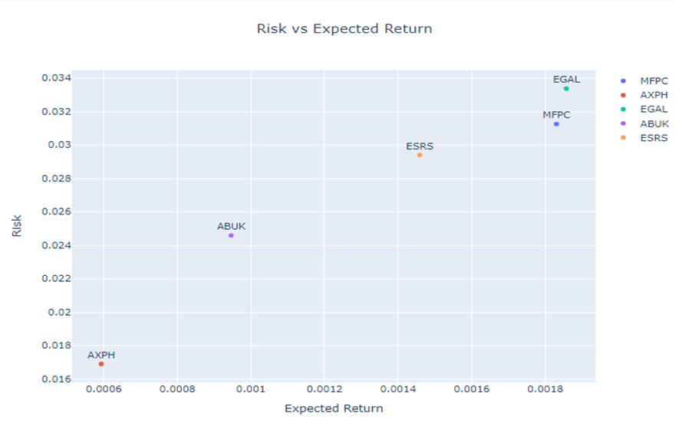
PROJECT STEPS
Data Analysis
FIGURE EXPECTED RISK AND RETURN FOR EACH COMPANY

Slide 19
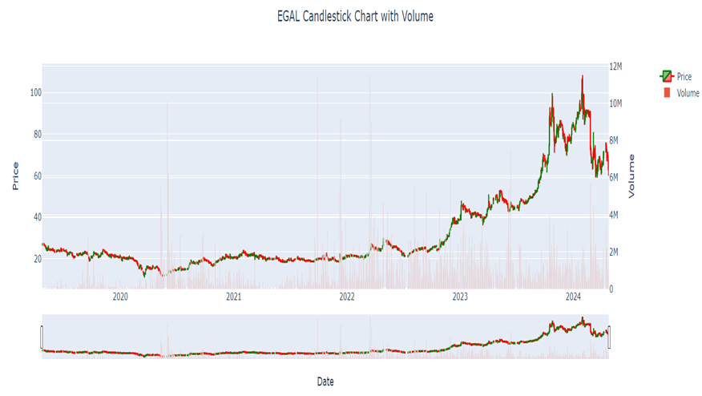
PROJECT STEPS
Data Analysis
Then visualize the stock price movements of a financial instrument and trading volume for EGAL using a candlestick chart and a volume bar chart.
FIGURE EGAL CANDLESTICK CHART WITH VOLUME

Slide 20

PROJECT STEPS
Predictive Model
LSTM is designed to avoid long-term dependency issues, making it highly suitable for time series data like stock prices.
Data splitting
Training data: The portion of the dataset used to train the model, usually around 80% of the total data.
Testing data: The portion of the dataset used to train the model, usually around 20% of the total data.

Slide 21
PROJECT STEPS
Predictive Model
Prediction process
Normalize the test data to match the scale of the training data.
Create sequences of 60-day windows for prediction.
Use the trained LSTM model to predict future prices.

Slide 22
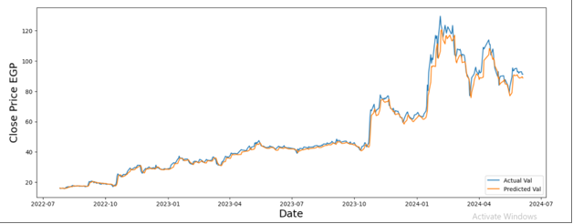
PROJECT STEPS
Predictive Model
Compare the predicted stock prices with the actual stock prices over time. This method helps in identifying how closely the model's predictions follow the actual stock price movements, making it easier to spot trends and discrepancies.

Slide 23
PROJECT STEPS
Predictive Model
The RMSE is a quantitative measure of the model's prediction accuracy. It calculates the average difference between the predicted and actual values, providing a single metric that quantifies the model's performance.
And this mean that RMSE = 3.5824 that LSTM model is providing reasonably accurate predictions for stock prices.

Slide 24

PROJECT STEPS
Predictive Model
early warning system
Help investors make informed decisions and mitigate financial risks.
Alerts are sent as notifications to users via an application or website. Example: "Early Warning: Significant Price Increase on 2024-07-01."

Slide 25
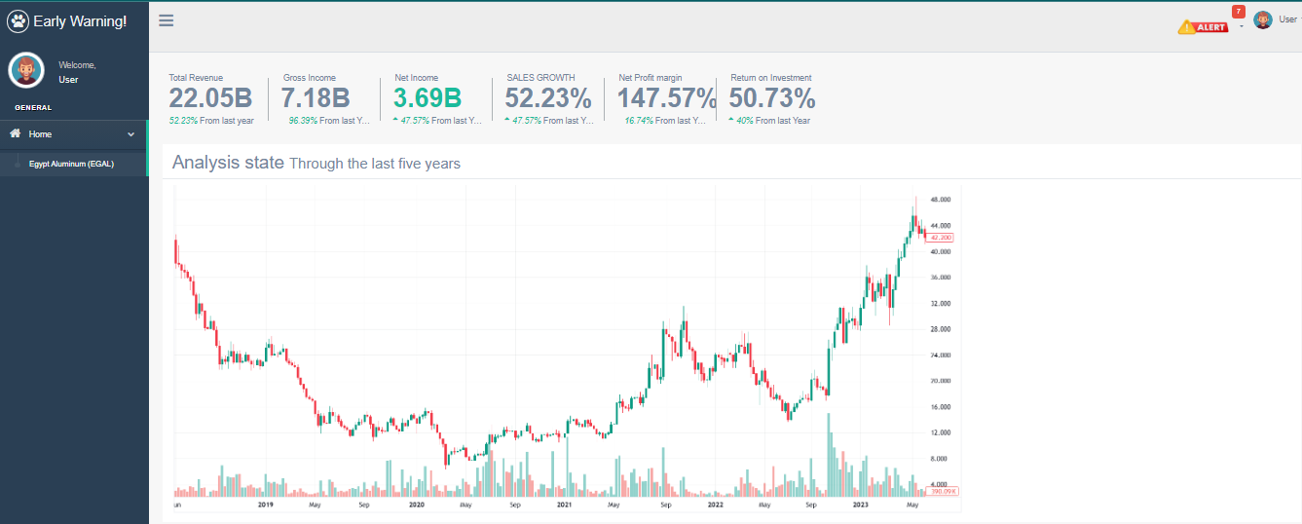
User interface

Slide 26
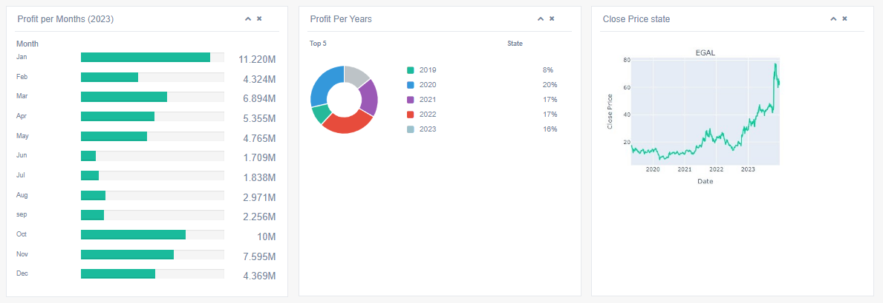
User interface

Slide 27
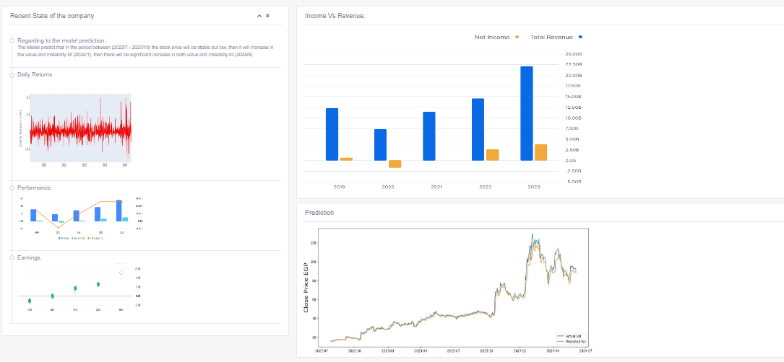
User interface

Slide 28

CONCLUSION

Slide 29

COCLUSION
Created a financial risk assessment early warning system using machine learning to predict stock prices of five Egyptian companies.
·Visualized price trends, trading volumes, and calculated metrics like daily returns and correlation matrices.
·Used historical stock prices and volumes to train an LSTM model for predicting future stock prices and assessing financial risks.

Slide 30

COCLUSION
The LSTM model's RMSE was approximately 3.582, indicating reasonable accuracy but room for improvement.
By this project we can help the investors to gain more accurate and timely insights into stock price movements, helping them make better-informed investment decisions. It also helps to assess potential financial risks more effectively, allowing for proactive risk management and mitigation strategies.

Slide 31

FUTURE
WORK

Slide 32

FUTURE WORK
Integrate additional data sources like social media sentiment, news headlines, and economic indicators.
Develop a friendly user interface that simplifies the prediction process and provides clear, easy-to-understand visualizations and explanations for the beginners. And also, it simplifies the prediction process and provides clear, easy-to-understand visualizations and explanations for the professionals and experts.

Slide 33

RELATED
WORK

Slide 34


RELATED WORK
STOCK MARKET PREDICTION USING MACHINE LEARNING (LSTM):
Supervised machine learning is employed on a dataset obtained from Yahoo Finance. This dataset comprises of the following five variables: open, close, low, high and volume.

Slide 35
RELATED WORK
STOCK MARKET FORECASTING USING MACHINE LEARNING ALGORITHMS:
They proposed a new forecasting algorithm that exploits the temporal correlation between global stock markets and different financial products to predict the next day's stock trend with the help of support vector machine SVM .

Slide 36
RELATED WORK
ANALYSIS AND PREDICTION OF STOCK MARKET TRENDS USING DEEP LEARNING:
Depicts a progressive conclusion on how we can use recurrent neural networks RNN in stock price forecasting.

Slide 37


Thank you!

